Slide 1
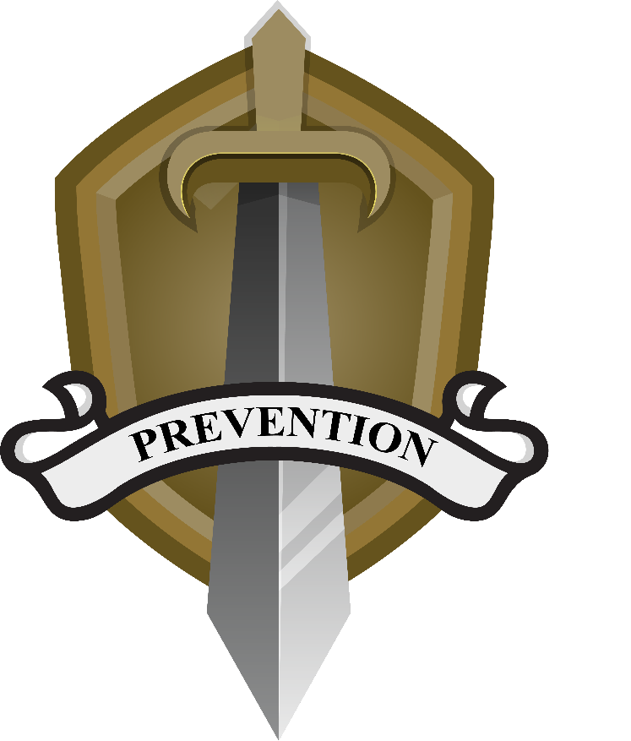

Hazing
An Overview of EEO Definitions, Impacts, and Prevention

Slide 2
Objectives
Define
Define
Distinguish
Distinguish
Understand
Understand
Review
Review
hazing.
between
hazing and
other
harassment.
the risk
factors and
impacts of
hazing.
preventative
strategies.

Slide 3
What Is Hazing?
“A form of harassment that involves conduct, without a proper governmental purpose but with a nexus to employment, intended to physically or psychologically injure or create a risk of physical or psychological injury to a person for the purpose of: initiation into, admission into, affiliation with, change in status or position within, or a condition for continued membership in any military or DoD organization.” (Office of the Under Secretary of Defense for Personnel and Readiness, 2020).
Notes:
Office of the Under Secretary of Defense for Personnel and Readiness. (2020, June 30). Harassment prevention and responses for DoD civilian employees. (DoD Instruction 1020.04). Department of Defense. https://www.esd.whs.mil/Portals/54/Documents/DD/issuances/dodi/102004p.pdf

Slide 4
Laws and Policies
Department of Defense Instruction (DoDI) 1020.04, Harassment Prevention Responses for DoD Civilian Employees
Applies to all DoD employee personnel at all levels
Establishes a comprehensive policy and procedures for preventing and responding to harassment within the U.S. military
Mandates reporting procedures and response strategies to effectively address incidents of harassment
Outlines the responsibilities of DoD employee personnel leaders to foster a respectful and professional environment

Slide 5
Other Important Terms
Bullying
“A form of harassment that involves aggressive acts intended to harm, either physically or psychologically, another person without a proper governmental purpose but with a nexus to employment...” occurring under specific circumstances outlined in DoDI 1020.04
Harassment
“Behavior that is unwelcome or offensive to a reasonable person and that creates conditions that interfere with work performance or creates an intimidating, hostile, or offensive work environment.”
Sexual Harassment
“Unlawful discriminatory harassment that is based on conduct of a sexual nature. It involves unwelcome sexual advances, requests for sexual favors, or other verbal or physical conduct of a sexual nature…” occurring under specific circumstances outlined in the DoDI 1020.04.
(DoDI 1020.04; Office of the Under Secretary of Defense for Personnel and Readiness, 2020)
Notes:
Office of the Under Secretary of Defense for Personnel and Readiness. (2020, June 30). Harassment prevention and responses for DoD civilian employees. (DoD Instruction 1020.04). Department of Defense. https://www.esd.whs.mil/Portals/54/Documents/DD/issuances/dodi/102004p.pdf

Slide 6
Hazing Versus Other Harassment. What’s the Difference?
Hazing
Other Harassment
Goal or purpose:
  Establish a place in the hierarchy
  Pay a “price” for group membership
  Share in a tradition (“right of passage”)
Occurs for a finite amount of time or until an established goal is reached
Consists of behaviors such as:
Derogatory language or name-calling
Demeaning or degrading acts
Forced intake of substances or foods
Sexual acts
Abusive pranks or tricks
Exclusion from groups or opportunities
Acts of physical harm
Goal or purpose:
  Single out
  Degrade
  Exclude
  Isolate
  Cause physical or psychological harm
Occurs for an indefinite amount of time
(DoDD 1020.04; Office of the Under Secretary of Defense for Personnel and Readiness, 2020)
Notes:
Also see: Harassment prevention and response in the Armed Forces (DoD Instruction 1020.03). (2022, December 20). Office of the Under Secretary of Defense for Personnel and Readiness. https://www.esd.whs.mil/Portals/54/Documents/DD/issuances/dodi/102003p.PDF

Slide 7
Hazing Versus Other Harassment. Specific Behaviors
Hazing
Other Harassment
Berating or belittling
Branding
Shaving
Forced Intake of substances, food, or water
Abusive Tricks
Pinning
Bondage
Sleep Deprivation
Sexual acts
Physical striking or hitting
Psychological abuse
Threats or manipulation
Discrimination based on protected categories (e.g., race, gender, sexual orientation, national origin)
Unwanted sexual acts
Unwanted sexual advancements or attention
Retaliation or reprisal in response to a protected communication
Stalking
Bullying
Methods or behaviors to establish control over another individual; power-motivated
(DoDD 1020.03; Office of the Under Secretary of Defense for Personnel and Readiness, 2022)
Notes:
Also see: Harassment prevention and response in the Armed Forces (DoD Instruction 1020.03). (2022, December 20). Office of the Under Secretary of Defense for Personnel and Readiness. https://www.esd.whs.mil/Portals/54/Documents/DD/issuances/dodi/102003p.PDF

Slide 8
Hazing Versus Other Harassment. Other Comparisons and Contrasts
Hazing
Other Harassment
Usually occurs in a public setting
Justified as a method of team building
Often top-down, organized and orchestrated by more seasoned group members
Abuse of power
Negative physical and psychological impacts
Often encouraged, supported, or allowed through cultural acceptance within the climate
Usually occurs in more private settings
Intended to separate target or exclude
May occur from any direction within the social hierarchy

Slide 9
Identifying Hazing
Hazing can be defined by three core characteristics that make it different from other forms of harassment.
Hazing
Consent from the target
Tradition
Membership
Notes:
Hazing typically occurs with some degree of consent from the target, though it is still hazing, and therefore harassment, even if it the target consents to participate.
Hazing is most often designed around a tradition or established practice that occurs for a finite amount of time or until a goal is met.
Hazing is intended to result in feelings of acceptance and group membership at its conclusion.

Slide 10






Individual Impacts of Hazing
Compromised mental health¹
Increased likelihood of sexual assault³
Lower job satisfaction²
Impaired physical health¹
Increased likelihood of substance use¹
Notes:
Campbell-Sills, L., Sun, X., Kessler, R. C., Ursano, R. J., Jain, S., & Stein, M. B. (2023). Exposure to bullying or hazing during deployment and mental health outcomes among US Army soldiers. JAMA network open, 6(1), e2252109-e2252109.
Baker, M. T., Ojeda, A. R., Pressley, H., Blalock, J., Martinez, R. A., Moore, B. A., & Van Hasselt, V. B. (2023). Military sexual violence: Sexual assault, sexual harassment, and sexual hazing. In Violence in the Military (pp. 19-31). Cham: Springer Nature Switzerland.
Godier-McBard, L. R., & Jones, M. L. (2020). Same-sex sexual violence in the military: A scoping review. Journal of Military, Veteran and Family Health, 6(2), 68-84.

Slide 11





Team Impacts of Hazing
Diminished trust in other team members¹
Inhibited faith in leaders or supervisors¹
Weakened team cohesion¹
Notes:
1. Office of the Under Secretary of Defense for Personnel and Readiness. (2020, December 29). Harassment Prevention and Response for DoD Civilian Employees (DoD Instruction 1020.04). https://www.esd.whs.mil/Portals/54/Documents/DD/issuances/dodi/102004p.pdf

Slide 12





Organization Impacts of Hazing
Compromised core values¹
Loss of personnel^{2,3}
Impaired reputation¹
Decreased mission readiness⁴
Notes:
Allan, E. J., Payne, J. M., Boyer, A., & Kerschner, D. (2018). Hazing prevention toolkit for campus professionals. Hazing Prevention Consortium.
Clare, R., Lawhead, A., Dahl, J., Klahr, A., Schreiner, J., Moore, A., Neria, A., McGrath, D., Murray, C., Peebles, H., Trump-Steele, R., Hylton, K., Harcey, S., Vega, R., Tuskeviciute, R., Tercha, J., Barry, A., Owen, B., & Mirani, K. (2021). Defense Organizational Climate Survey (DEOCS) redesign: Phase 1 overview report (OPA Report No. 2021-158). Office of People Analytics.
Government Accountability Office. (2023). DoD Active-Duty Recruitment and Retention Challenges. (GAO-23-106551). https://www.gao.gov/products/gao-23-106551
Office of the Under Secretary of Defense for Personnel and Readiness. (2020, December 29). Harassment Prevention and Response for DoD Civilian Employees (DoD Instruction 1020.04). https://www.esd.whs.mil/Portals/54/Documents/DD/issuances/dodi/102004p.pdf

Slide 13
Strategies to Prevent Hazing
Primary
Primary strategies are aimed at preventing hazing behaviors.
Secondary
Secondary strategies guide an expedited and efficient response to hazing behaviors.
Tertiary
Tertiary strategies aim to mitigate the lasting effects of hazing behaviors.

Slide 14
Primary Prevention Strategies
Educational Programs
Develop and implement comprehensive training sessions, which should be mandatory for all levels of personnel.
Standardizing Definitions and Policies
Definitions, explanations, and policies related to hazing behavior should be consistent within the organization.
Promoting a Positive Reporting Culture
Encourage a culture where all personnel feel safe and supported when reporting and leaders are viewed as a safe resource for reporting a problem.

Slide 15
Secondary Prevention Strategies
Responsive Investigation Systems
Create a robust and consistent system for investigating reports of hazing that is prompt and efficient. Reports should clearly distinguish hazing from other forms of harassment
Support Systems for Targets
Provide strong support systems for targets of hazing that include dynamic options for support, such as military and community sponsored options.
Accountability Measures
Ensure all steps to hold offenders accountable are enforced fairly and consistently.

Slide 16
Tertiary Prevention Strategies
Policy Development and Evaluation
Evaluate how current policies meet the needs of the work environment, as evolutions in working style, procedures, and available resources can sometimes leave policies obsolete or inadequately applicable.
Data Collection and Analysis
Implement and maintain a centralized process for tracking reports of hazing for periodic analysis. Hazing that is apart from and includes other forms of harassment should be reviewed.
Promote Positive Behavior Standards
Supervisors should prioritize time to plan group activities where participants engage with a unified goal in a positive way.
Notes:
For more information on prevention strategies for hazing, see the strategies sheet for hazing EEO in the DEOMI toolkit.

Slide 17
Summary
Defined hazing.
Distinguished the difference between hazing and other forms of harassment.
Explored and gain an understanding of the impacts of hazing
Reviewed preventative strategies and reporting procedures

